Slide 1
Environmental Testing, Design, Analysis for HABs
By: Ara Kourchians (arko)

Slide 2
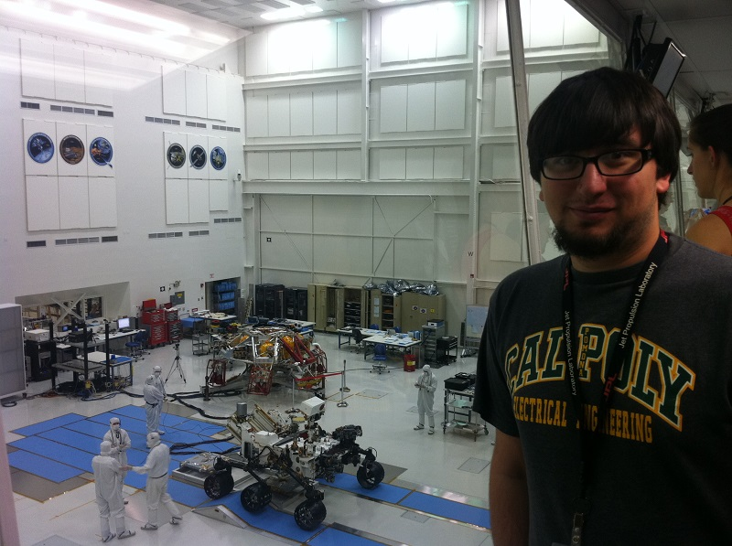
About Me
Undergrad at Cal Poly Pomona
Electrical Engineering – emphasis in control systems
Work for JPL/NASA
Software engineer for electronic part reliability testing/reporting systems
Previous projects and work
Omni-directional drive system robots
Self-balancing robots
Time machines
Harsh environment sensors
Plasma Lighting RF Ballasts
Many self-funded projects
DISCLAMER
I am NOT here to represent JPL/NASA, all opinions are my own. Information provided is publically available information (google it yo).

Slide 3
Assumptions
You already know what a HAB is
Basic understanding of electronics and physics
Goal: Increase the reliability of your HAB

Slide 4
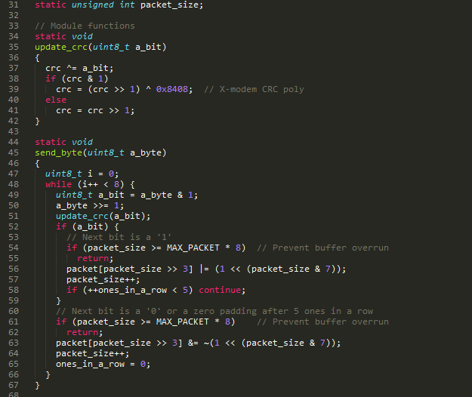
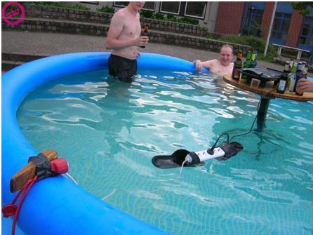
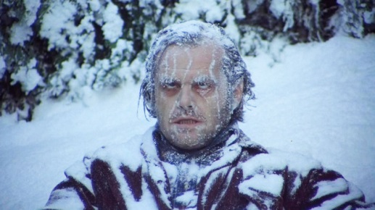
Failure
Software
Power/Radio Hardware configuration
Environment

Slide 5
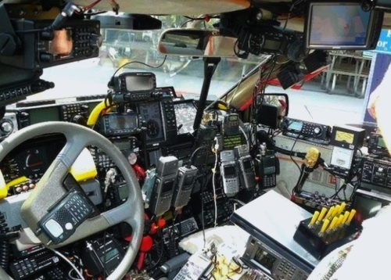
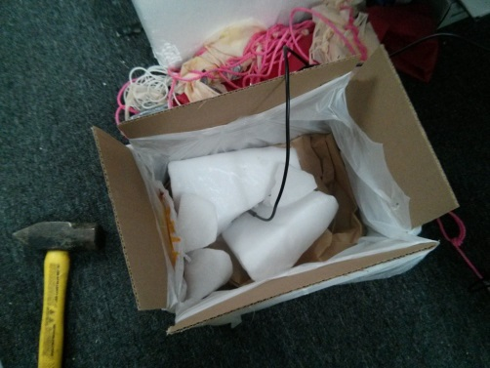
TESTING TESTING TESTING
Software
Test Harness
Full flight systems test without debugger, power supply, etc
“Pretend you are going to launch it”
Power/Radio Hardware configuration
Know your datasheets
Full battery test
Range test & dry run
EMC
Environment
Cold, Vacuum, IR, Shake
Input
Code
Output
Verify

Slide 6
Software Testing
Unit Testing
Make up data
neg/pos lat/long
Test cases
Bad NMEA packet
GPS signal loss
Reset Procedure
Proper FSM
Integration/System Testing
Static Testing
Peer review
Static Code Analysis
KNOW YOUR EMBEDDED HARDWARE AND COMPILER
Input
GPS
Code
Output
Verify
Input
Radio Code
Output
Verify
Input
System Code
Output
Verify
Input
GPS
Code
System Code
Radio Code
Output
Verify

Slide 7
Software Standards
What does JPL do? (YES THIS IS PUBLIC INFO)
People hate following rules and want to follow their own
Pick 10 standard/rules and make them easy to remember
Each tied to a real failure
Power of 10 Rules for developing safety-critical code (C language)
No spaghetti code flow (goto, recursion, etc)
All loops must have fixed bounds (stops runway code)
Avoid heap memory allocation (avoid malloc() )
Keep function line count short (less than ~60 lines)
At least two runtime assertions per function (verify conditions pre/post func)
Keep data objects at smallest possible level of scope
Check functions return value or cast as void, check function input parameters
Use precompiler for headers and simple macro definitions
Limit pointer use to a single dereference, no function pointers
Warnings are errors, must compile with no warnings (set compiler to most pedantic)
Lock down code, any changes means going back and testing all over again
http://web.eecs.umich.edu/~imarkov/10rules.pdf
http://lars-lab.jpl.nasa.gov/JPL_Coding_Standard_C.pdf

Slide 8
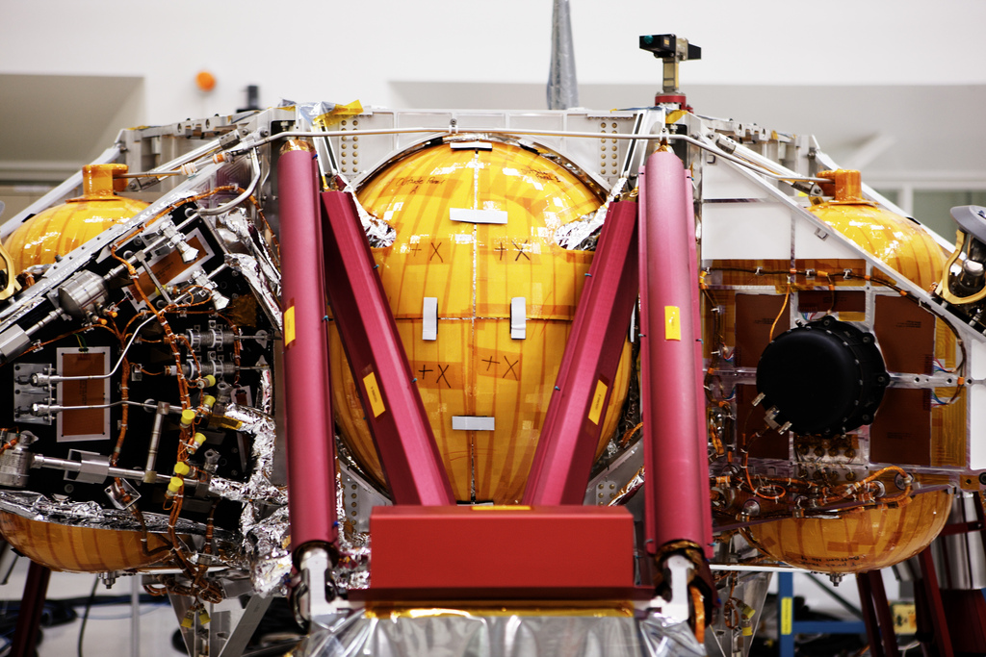
Photographer: Joseph Linaschke

Slide 9
Power/Radio hardware testing
Know your datasheets, estimate power draw
Good connectors
Power supply test operating voltage range (Vmin to Vmax)
Estimate battery life
Full battery test
Range Test
A good distance
Notes:
-Run a power supply test, record current draw and characteristics, estimate battery lifetime
-Full battery test (run it till it dies)
-Get to know your datasheets, assure all parts are operating within expected conditions (not drawing too much or too little current, etc)
-Range Test – Have a buddy drive the payload around in a car, find a distant mountain (or hill if you are in the uk). Using flight hardware and ground radio systems to test.
-EMC Testing – Could be as simple as running all your radios close to each other.
-Transmit your ham gear near it to test robustness
-List what an emc test includes, and why most are unnecessary

Slide 10
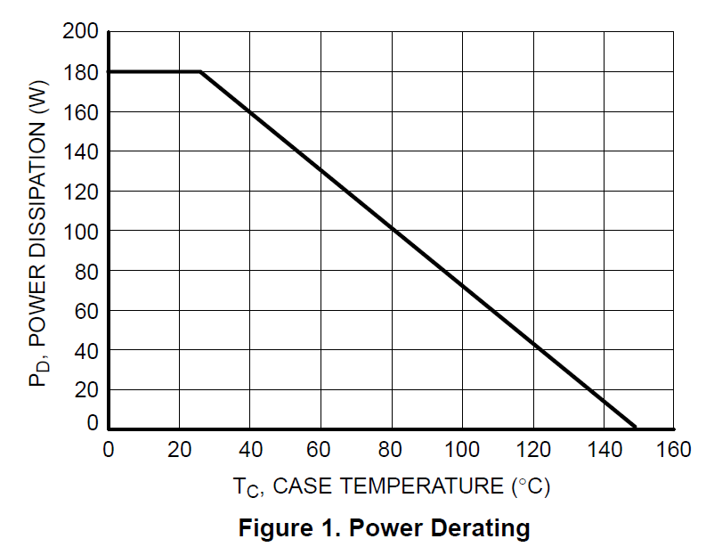
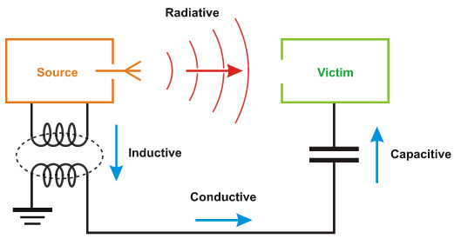
EMC & Derating
Derating (not really necessary for HAB’s)
Run electronics below maximum rating to increase lifetime/reliability
Under clock CPU to prevent overheating
Prevent accidental damage
EMC
Capacitive, Inductive, Radiative, Conductive
Could be as simple as running all your radios close to each other
Power Amplifier degradation
General interference (especially RX)
Transmit your ham gear near it to test robustness
Commercial equipment is usually rated
Homebrew PCB’s are not rated
http://www.williamson-labs.com/ltoc/glencoe-emc-11.htm

Slide 11
RUN EMC
I.E. – Radiated Field Strength (dBuV/m)
Susceptibility
50
40
30
Emission
20
10
1
10
100
1000
10000
Frequency (MHz)

Slide 12
EMC
Radiated (30MHz – 10GHz)
Emission: Clock & data lines, switching power supplies, poor RF config
Susceptibility: Clock & data lines in bad places, bad termination
Solution: Balance transmission lines, ground planes, shielding, correct termination, filters, differential lines
Conducted (100kHz – 30MHz)
Emission: Switching power supplies, motors, switches, relays
Susceptibility: Noisy AC power, Poor decoupling on power
Solution: Decoupling, power filters, shielding, ground planes
http://www.williamson-labs.com/ltoc/glencoe-emc-11.htm

Slide 13
Environmental Road Map
Understand the environment
Design/Understand your hardware
Determine tests
Build test rig
Test
Analyze
Redesign

Slide 14
Environment
What are the expected environmental conditions of nearspace?
Air Temperature: -60C to +40C
Pressure: 0.01atm (1010Pa) to 1atm (101325Pa)
Winds: 0mph – 100mph
Forces: up to 10g
Humidity: 0% - 100%
Solar Heat (Irradiance): 180 W/m^2 - 340 W/m^2
Radiation: <0.1krad/year (to put into perspective: HAB experiences 1 CT scan for each day of flight)

Slide 15
Environment
What are the expected environmental conditions of nearspace?
Air Temperature: -60C to +40C
Pressure: 0.01atm (1010Pa) to 1atm (101325Pa)
Winds: 0mph – 100mph
Forces: up to 10g
Humidity: 0% - 100%
Solar Heat (Irradiance): 180 W/m^2 - 340 W/m^2
Radiation: <0.1krad/year (to put into perspective: HAB experiences 1 CT scan for each day of flight)
Your HAB would need to fly for 10 years at 30km for radiation
to become a legitimate concern

Slide 16
Environment
IR Sky
Solar Flux
Convection
Albedo Cloud
Radiation
Albedo Ground
IR Ground

Slide 17
Environment
IR Sky
Solar Flux
Convection drops off after 18,000m
Convection
Albedo Cloud
Radiation
Albedo Ground
IR Ground

Slide 18
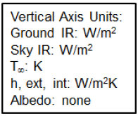
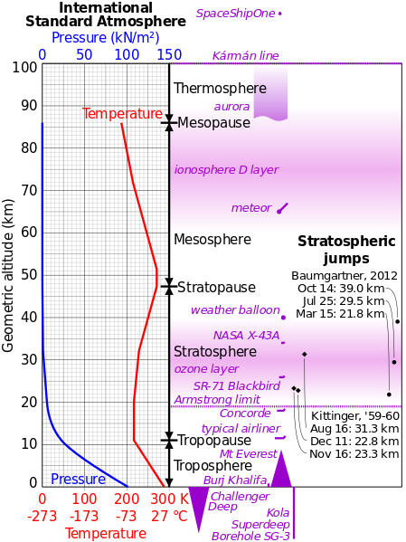
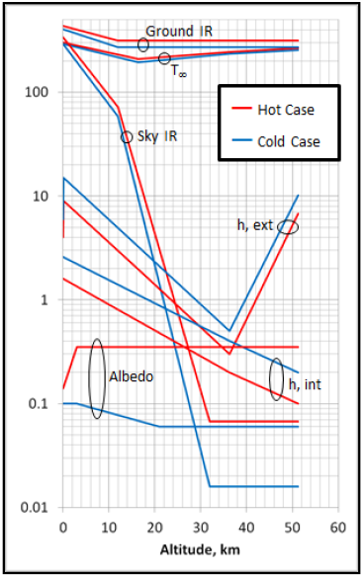
Environment
Babbage,
2013
43rd International Conference on Environmental Systems Thermal Design and Analysis of the Supersonic Flight Dynamics Test Vehicle for the Low Density Supersonic Decelerator Project
(doi: 10.2514/6.2013-3348) http://arc.aiaa.org/doi/abs/10.2514/6.2013-3348

Slide 19
Understand your hardware
Datasheets
Operating Temperature
Heat generated (depends on parts)
Your HAB falls in two categories
Hot HAB – Overheats & fails at altitude
Power regulator, powerful processor, etc
Cold HAB - Freezes & fails at altitude
Low power parts

Slide 20
What are you testing?
Can your HAB survive the expected temperatures?
Electronic parts (-40C – +80C)
How well does your insulation work?
Does your HAB overheat? (Do your parts need cooling?)
Camera
Power Regulator
Cutdown
“New Tech” or “mystery box”
Anything that acts significantly different in a vacuum

Slide 21
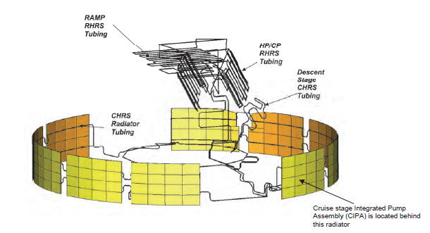
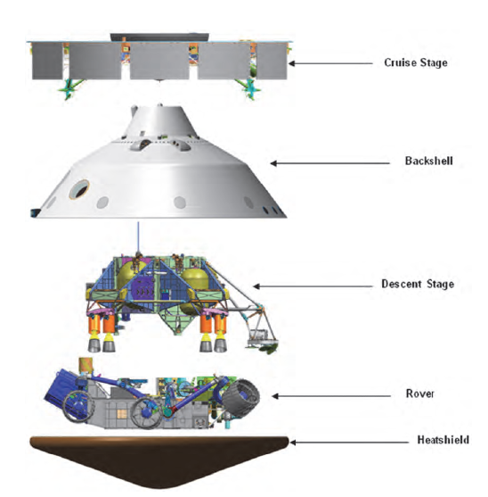
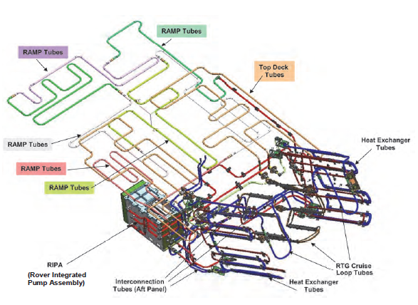
Spacecraft Thermal Modeling
Model & Simulate
“Everything on” (Hottest Case)
“Bare minimum” (Coldest Case)
http://www.esmats.eu/amspapers/pastpapers/pdfs/2012/johnson.pdf

Slide 22
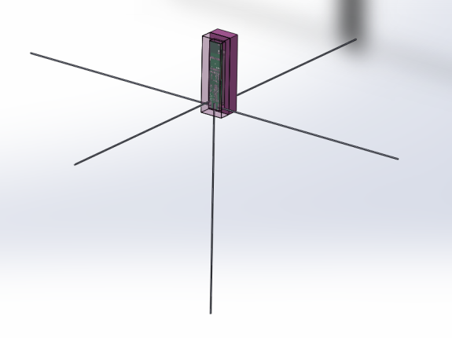
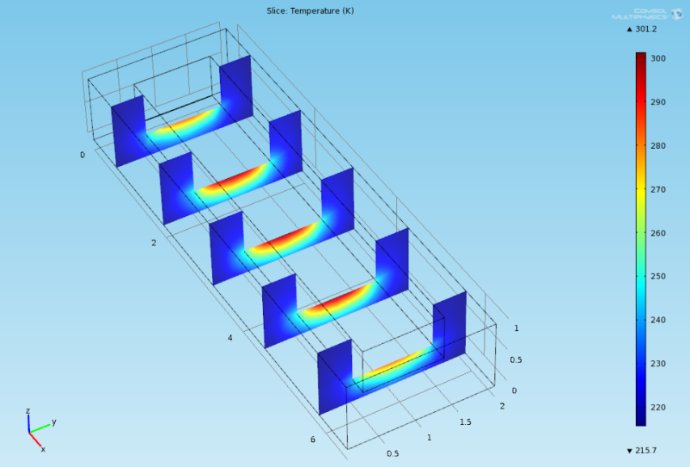
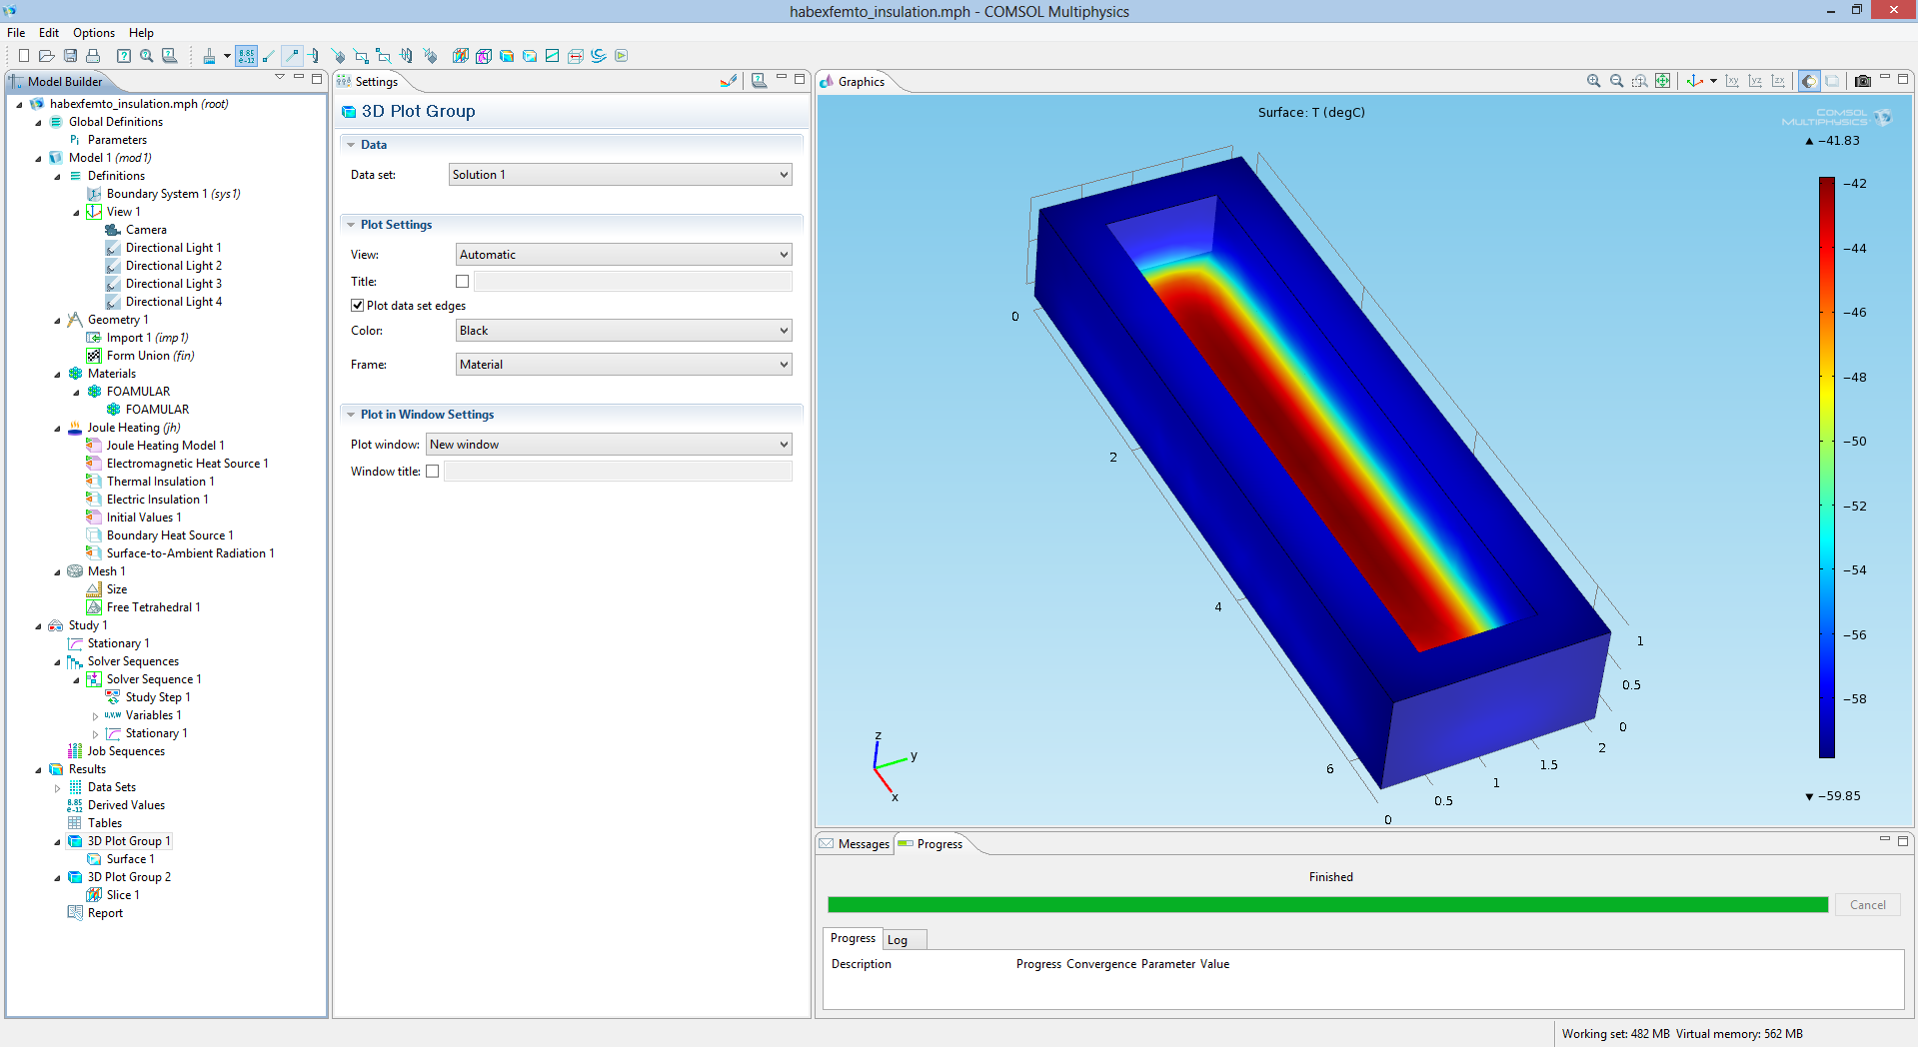
HAB Thermal Modeling

Slide 23
How do you know if you’re a hot or cold HAB?
Just test it!
Room temperature / Ice test
Cheap ($10)
Test parts to rating
Answers questions like:
does temp increase at room temp?
How do the characteristics change at cold?
Build Thermal/Vacuum/IR chamber
Expensive ($100-200)
Good test & data

Slide 24
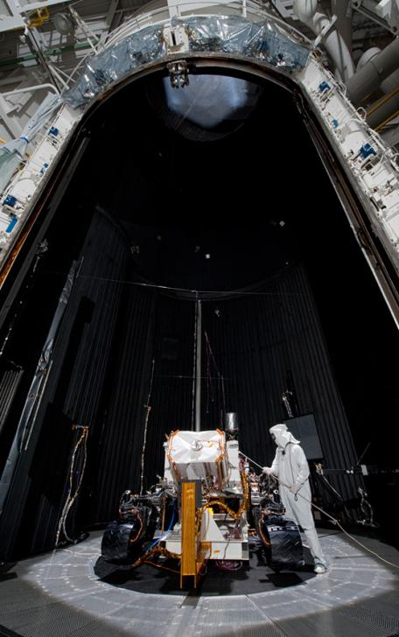
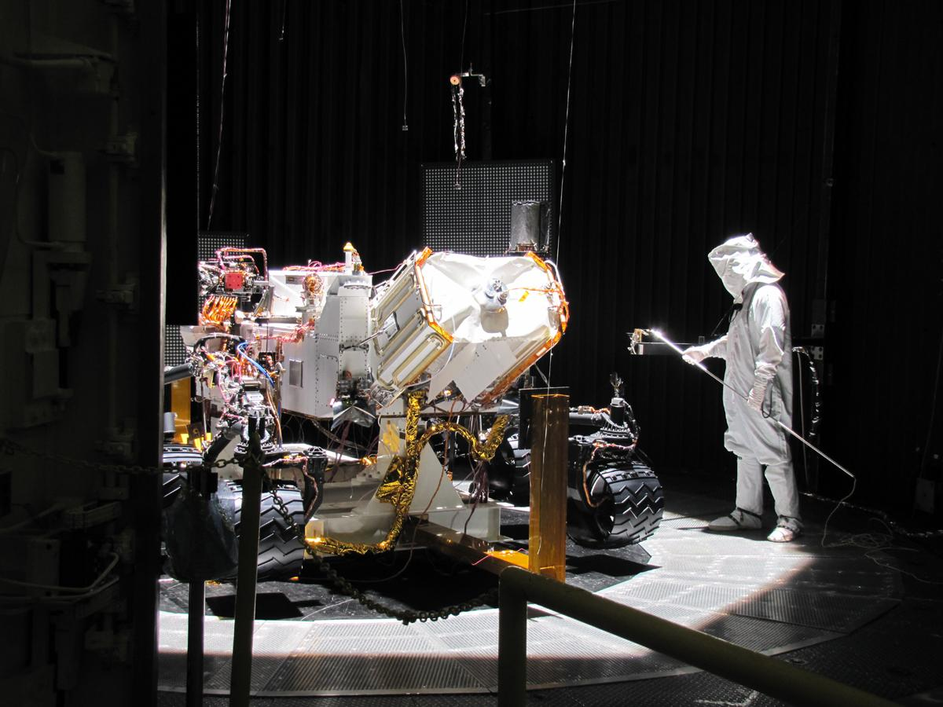
Environmental Chamber (on a NASA budget)

Slide 25
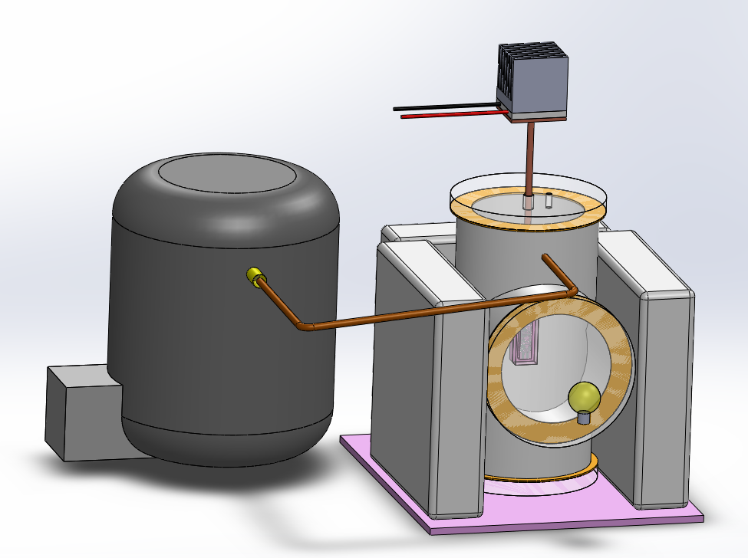
Environmental Chamber (on a budget $100-$200)
Air Temperature -60C to +40C: Dry Ice, Hair Dryer
Pressure 0.01atm to 1atm: Refrigerator Pump
Solar heat 184 W/m^2 - 341 W/m^2 : Light Bulb, Heat lamp
Winds/Forces up to 10g: Stairs (Ed Method)
Humidity 0% - 100%: Spray Bottle

Slide 26
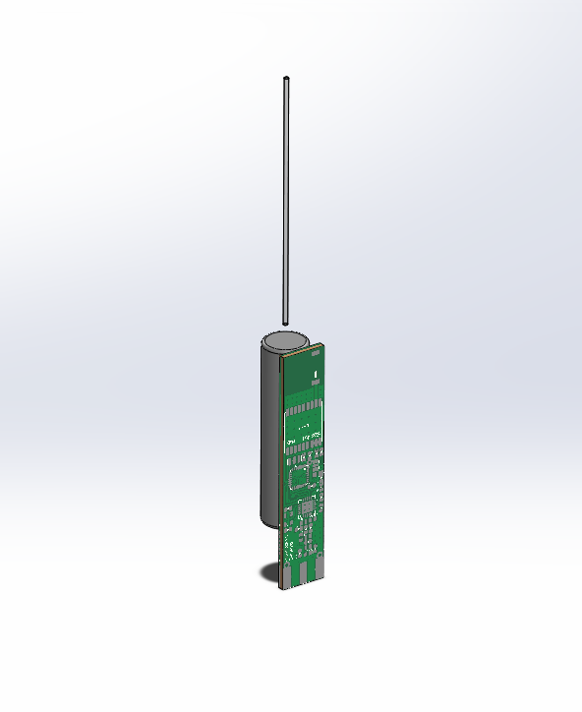
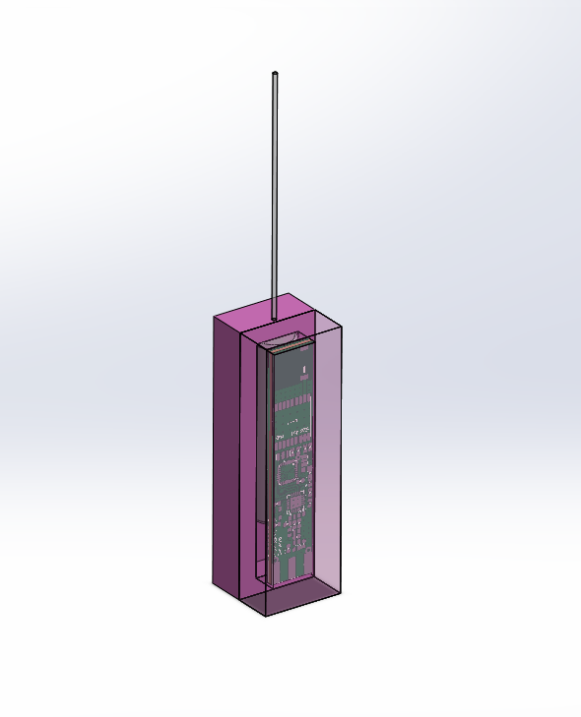
ENV Chamber Design

Slide 27
ENV Chamber Design - Vacuum
12.7mm polycarbonate
glass
Vacuum
Pump
Silicone Rubber
Schedule 40 PVC Tee

Slide 28
ENV Chamber Design - Cold
Peltier
Cooler
Heat sink
Heat Transfer Rod
Dry Ice

Slide 29
ENV Chamber Design – Solar Heat
Light Bulb

Slide 30
Setup
Vacuum of nearspace
Deep space or ground
Sun
HAB

Slide 31
Setup
Vacuum of nearspace
Dry Ice
Deep space or ground
Sun
HAB

Slide 32
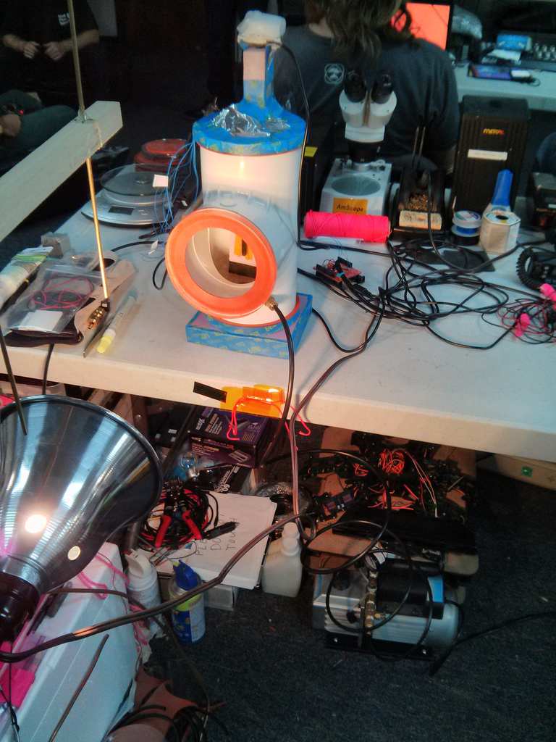
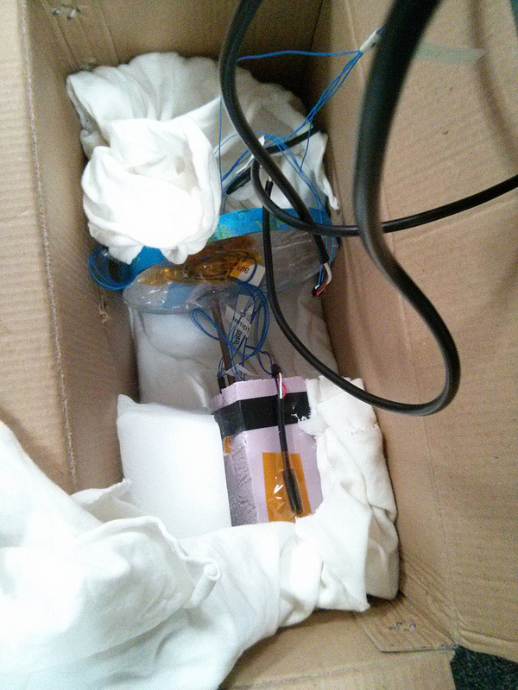
Setup – External Cooling

Slide 33
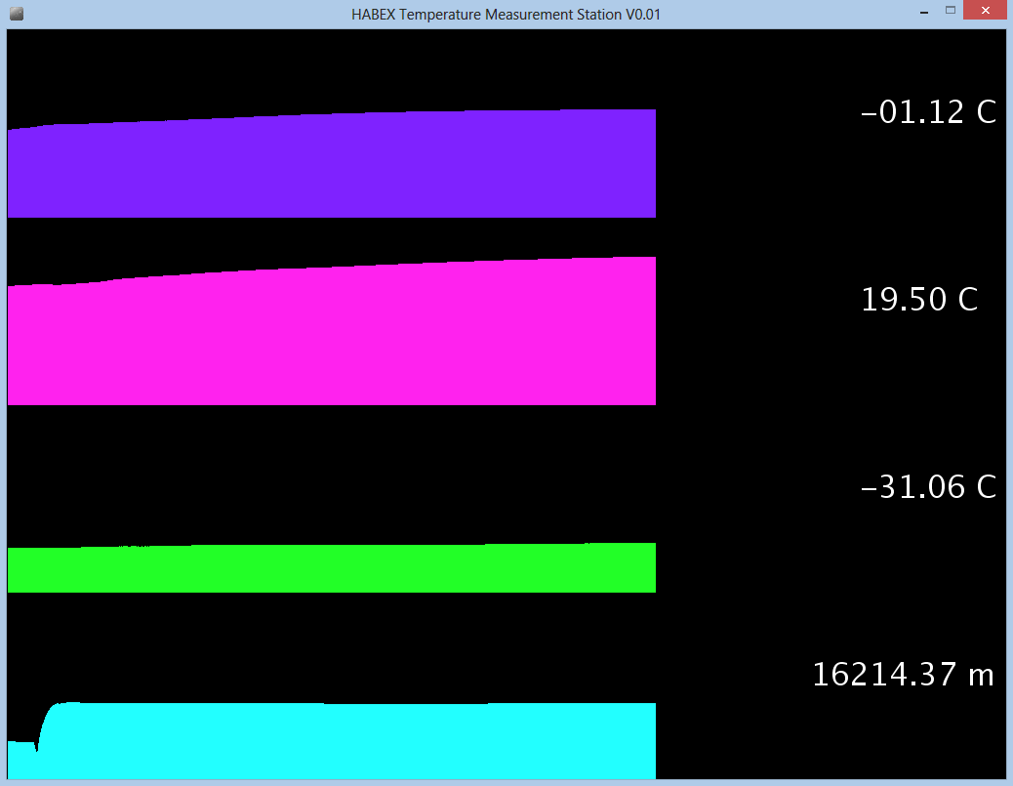
Poor Results
DEEP SPACE SIDE
SUN SIDE
Cooling Rod
Altitude

Slide 34
Setup
Vacuum of nearspace
Deep space or ground
Fishing Line
Sun
Dry Ice
Cloth
HAB
Note: Vacuum pump must run continuously

Slide 35
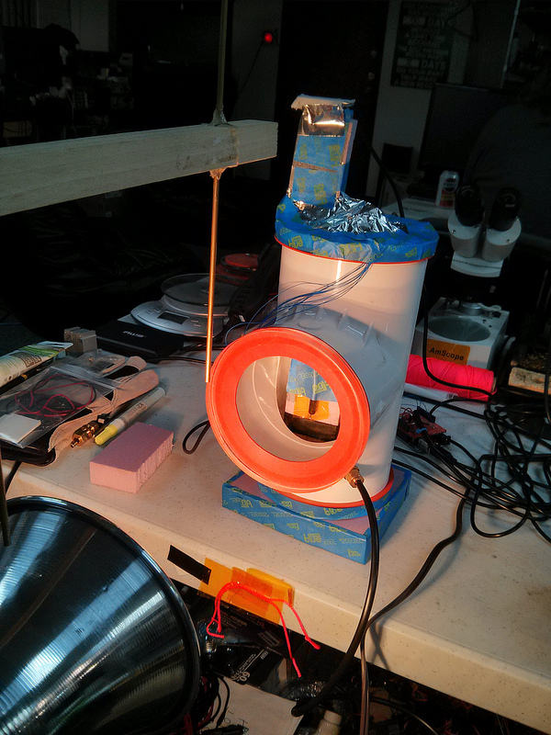
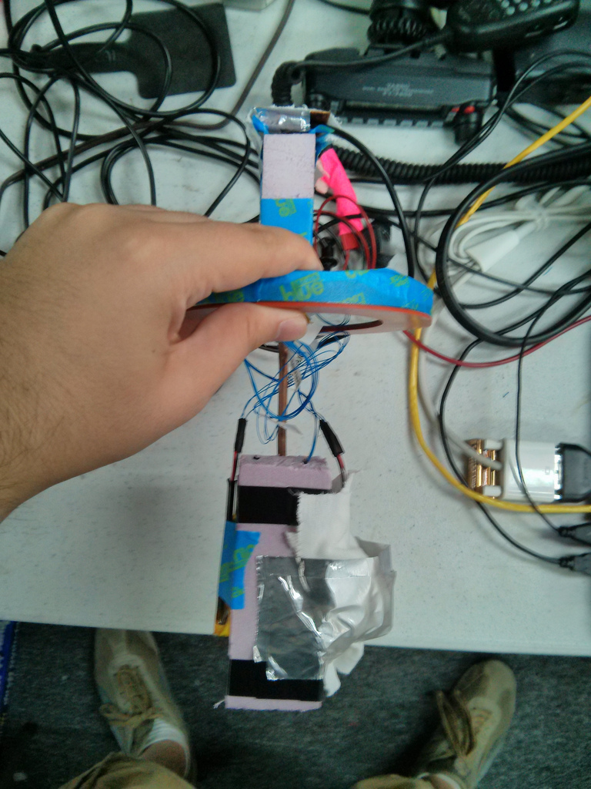
Setup – Internal Cooling

Slide 36
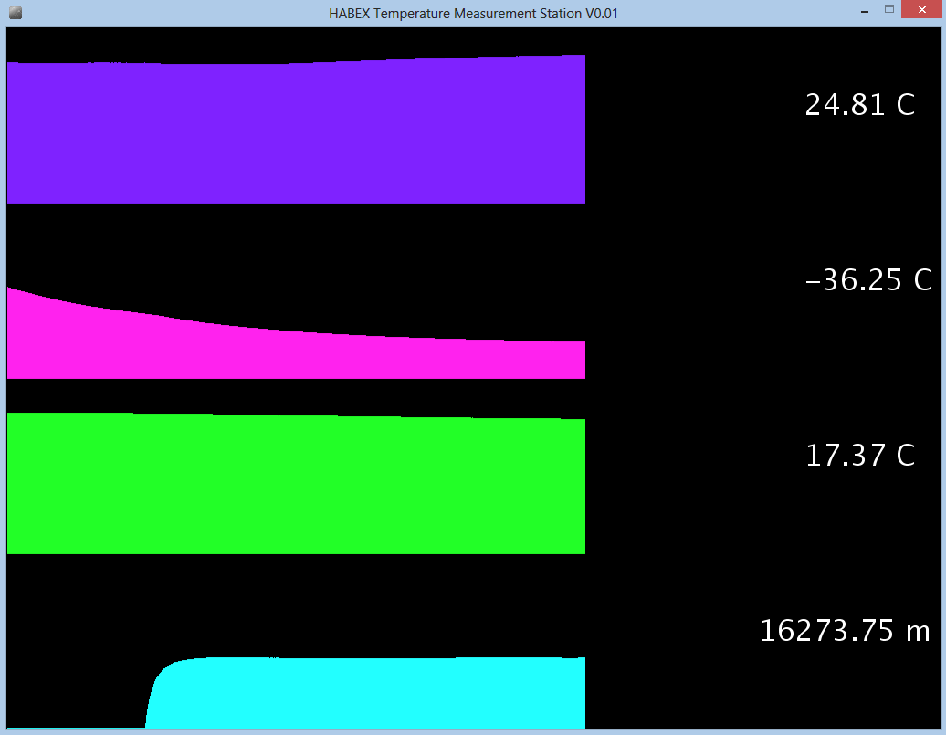
Good Results
SUN SIDE
DEEP SPACE SIDE
Chamber Wall Temperature
Altitude

Slide 37
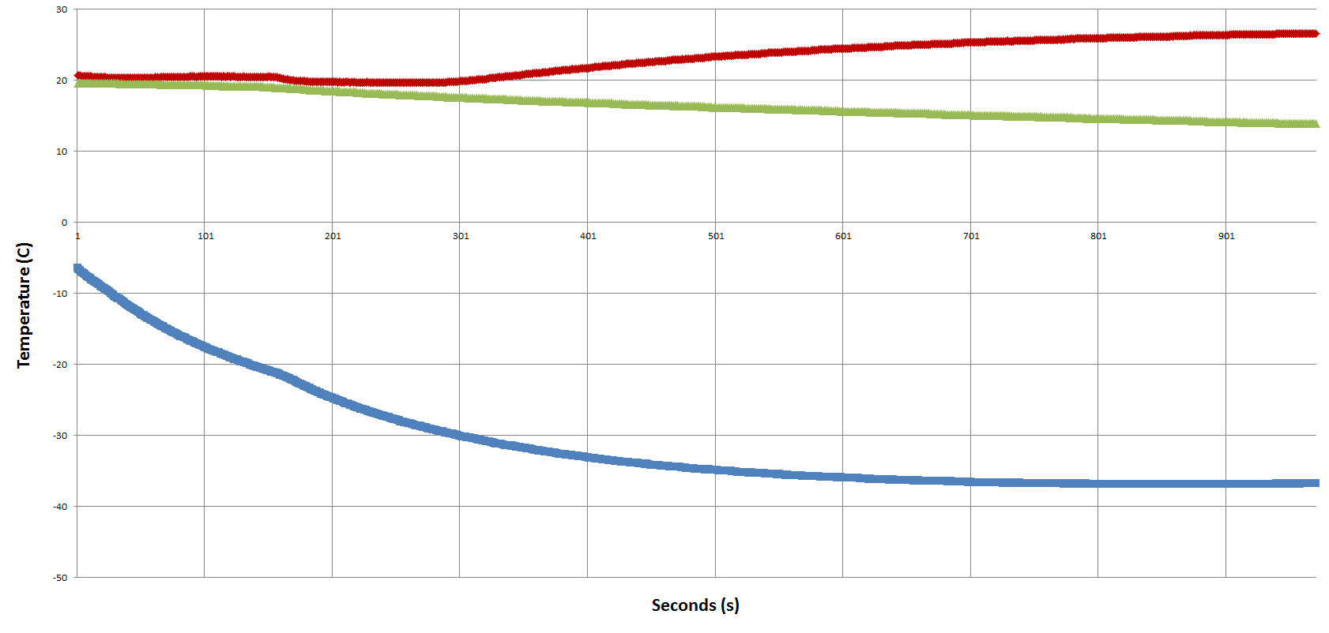
Results
- Sun Side
- Internal
- Deep Space Side

Slide 38
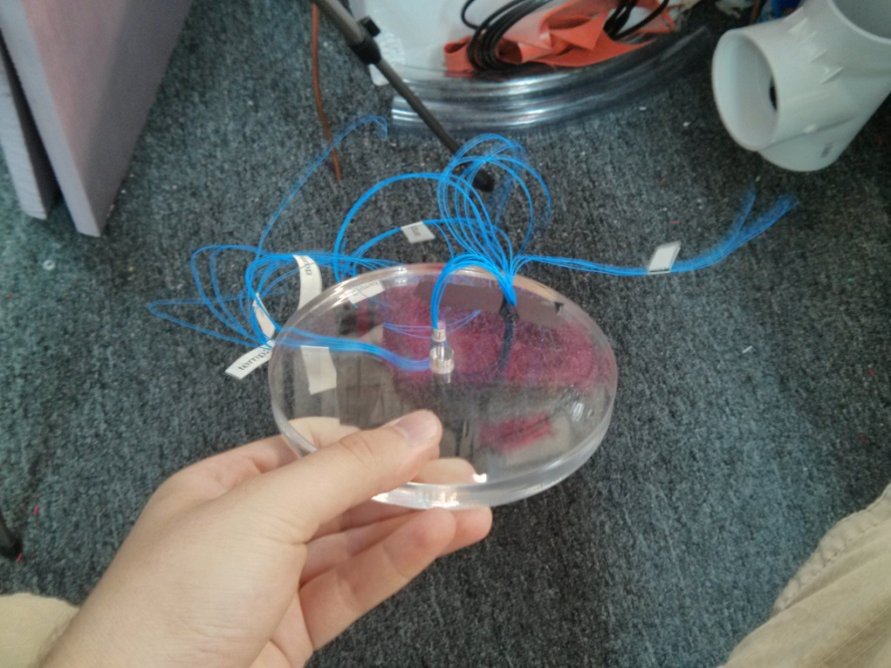
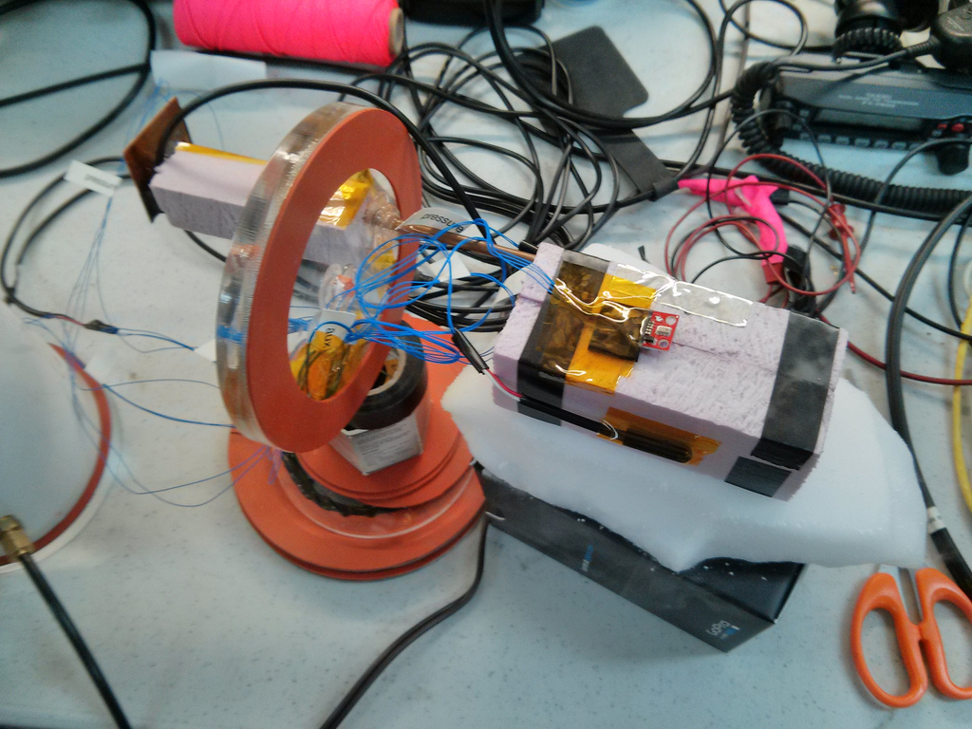
Measurements

Slide 39
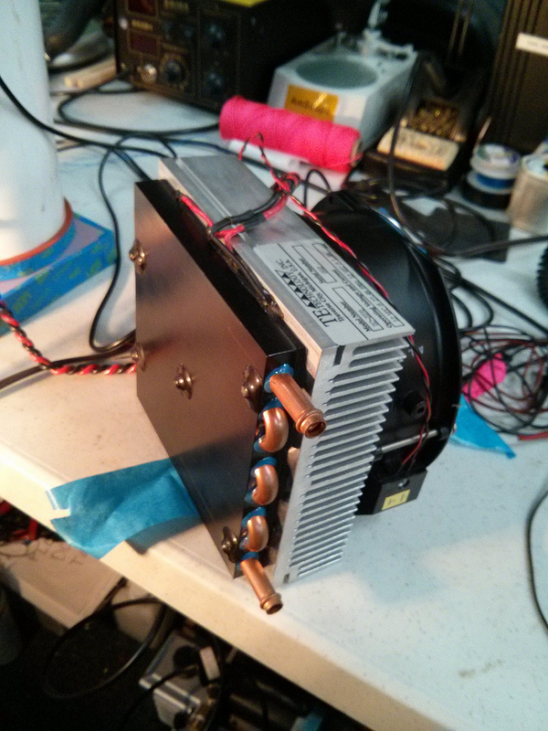
Design Improvements
Thermal shroud with Liquid Nitrogen, cold isopropyl, or glycol pumped through the walls
Proper coating for maximum thermal absorptivity
Control System
Lazy Susan

Slide 40
Now you know…
But how do you solve these thermal problems?

Slide 41
Solving the thermal problems
Hot HAB
Radiator – Copper braid & white acrylic paint (high emissivity)
Aluminum foil or heat blanket (low absorptivity)
Software (turn things off when not in use, underclock, etc)
Single/Multiple component heating is solved with radiators
Place radiators on sides or bottom
Radiator
Earth State
Hot HAB
Deep Space
or
Ground
http://ukhas.org.uk/guides:materials
http://www.engineeringtoolbox.com/emissivity-coefficients-d_447.html
http://www.engineeringtoolbox.com/radiation-surface-absorptivitie-d_1805.html

Slide 42
Solving the thermal problems
Cold HAB
Insulate - Foamular or Styrofoam (extruded polystyrene)
Black body - Acrylic craft paint (high absorptivity)
Heater (wastes power, should have a control system to prevent becoming Warm HAB)
Heater
Earth State
Cold HAB
Insulate
http://ukhas.org.uk/guides:materials
http://www.engineeringtoolbox.com/emissivity-coefficients-d_447.html
http://www.engineeringtoolbox.com/radiation-surface-absorptivitie-d_1805.html

Slide 43
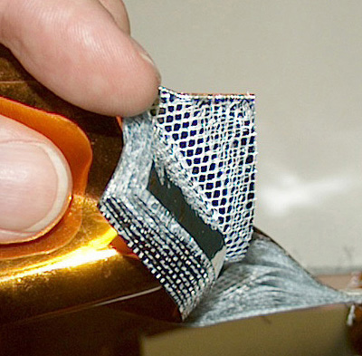
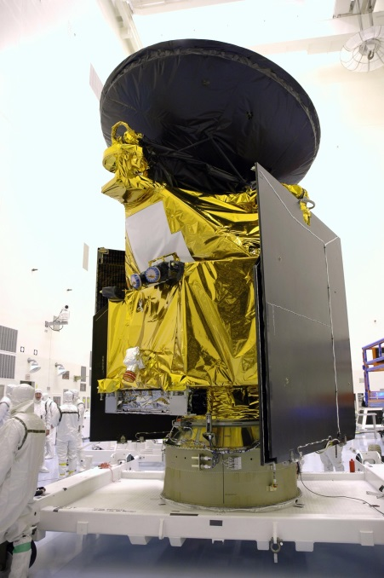
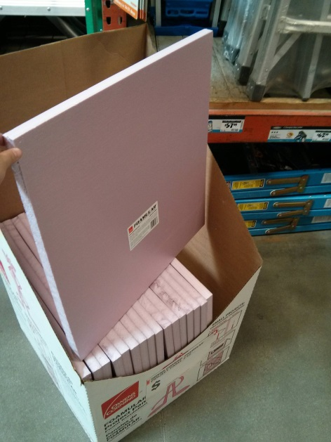
Solving the thermal problems
MLI (Multi Layer Insulation)
Aluminum or Silver
Mylar
Kapton
Polyester mesh
R-value of >>5 K*m^2/W
Foamular
R-value of 0.88 K*m^2/W
http://ukhas.org.uk/guides:materials

Slide 44
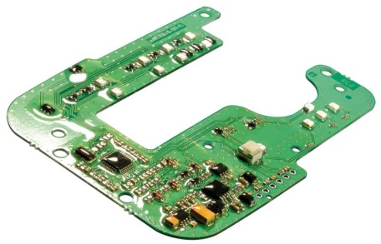
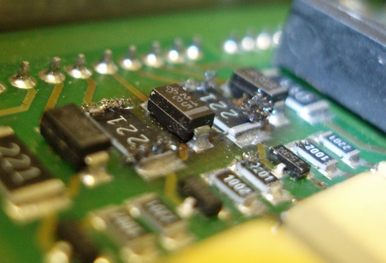
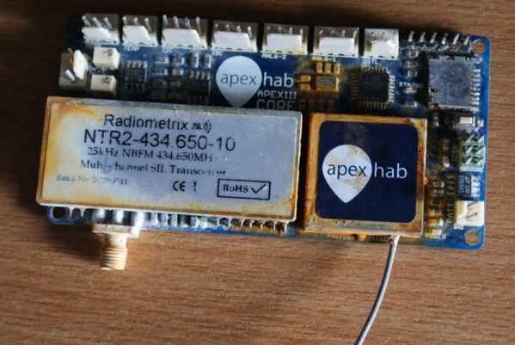
What is Conformal Coating?
Non conductive dielectric layer for protecting PCB’s
Why Conformal Coating?
Thermal stability and evenness
Conductive heat transfer
Corrosion prevention
Humidity
Accidental shorting
Whiskering
NOTE: Thermal expansion could damage parts
Courtesy of DanielSaul

Slide 45
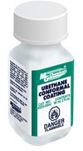
Conformal Coating
Acrylic
Low cost, durable, water resistant, fast dry
Silicone
Temperature resistant, flexible, water resistant, great insulator
Urethane
Chemical/Corrosion protection, thermal shock, moisture resistant
Application: Avoid bubbles, don't go too thick or too thin
Recommended Suppliers: MG Chemicals, Techspray
http://www.humiseal.com/product-selector/conformal-coating

Slide 46
Thanks!
Questions?
Email: arko2600@gmail.com
arkorobotics.com/env

